Slide 1


A.G.M RURAL COLLEGE OF ENGINEERING AND TECHNOLOGY VARUR, HUBBALLI (Department Of Computer Science Engineering)
Final Year Project
“AGROSHAKTI”
Project Coordinator: - Prof. Vinaykumar Beelagi Presented by:-
Project Guide :- Dr. Surekha Pinnapati Mr. Aman A Gujjar – 2AV21CS004
Mr. Mohammed Ansar Hansi – 2AV21CS030
Ms. Nameera Khatib – 2AV21CS032
Ms. Vidya Yaligar – 2AV21CS061

Slide 2
CONTENTS
Introduction
Problem Definition
Need For The Project
Scope and Significance
Literature Survey
Gaps in Existing Technology
Problem Statement & Solution

Slide 3
Objective
Methodology (4 Stages)
Reqirements
Technologies Used
Results
Conclusion & Future Scope
References

Slide 4
Introduction
Agriculture has been a fundamental pillar of human civilization, supplying essential resources and sustenance for generation.
Smart Farming: combine advanced technologies like the Internet of Things(IoT) and Artificial Intelligence(AI).
Farmers face issues like unpredictable weather, soil, degradation and delayed detection of crop diseases.
Sensor collect real-time data on soil moisture soil, temperature, humidity and light intensity.

Slide 5
Problem Definition
Unpredictable Weather: Farmers struggle with erratic weather patterns which impact crop planning and yield.
Delayed Detection of Diseases: Traditional methods are slow in identifying crop diseases.
Inefficiency in Resource Use: Without precise data, farmers may misuse water, fertilizers and pesticides.
Smart Solutions: using IoT and AI to crop monitoring and management.

Slide 6
Need For The Project
Growing population pressure
Problems with Traditional Farming
Demand for Sustainable Practices
Technology Advancements
Improved Decision-making
Food Security and Resource Management

Slide 7
Scope and Significance
It focuses on real of agriculture time monitoring and control monitoring and control.
The system uses unsupervised machine learning algorithms and predictive model.
It aims to cover large geographical areas.
Eco-friendly farming
Cost-Effectiveness
Future Innovation

Slide 8
Literature Survey
Title | Authors & Year | Key Focus | Methods/ Technologies Used | Findings | Relevance to Smart Agriculture
Evaluation of Machine Learning Approaches for Precision Farming in Smart Agriculture Systems | Ghulam Mohyuddin et al., 2024 | Comprehensive review of ML in precision agriculture | ML algorithms (SVM, CNN, RF), IoT, UAVs | ML enhances soil analysis, crop prediction, disease detection, and irrigation control | Demonstrates ML's critical role in transforming traditional farming into data-driven, efficient practices
Robust and Efficient Machine Learning Model for Smart Farming Decisions | S.K. Apat et al., 2022 | Development of a Heterogeneous Ensemble Learning Environment (HELE) | Random Forest, SVM, KNN, LSTM, IoT sensor data | HELE outperforms single models in yield prediction (up to 99.27% accuracy) | Highlights benefit of ensemble ML systems using real-time environmental data for smart decisions
LoRaFarM: A LoRaWAN-Based Smart Farming Modular IoT Architecture | Codeluppi et al., 2020 | Modular IoT system for data collection and monitoring | LoRaWAN, WSNs, cloud-based dashboards | Deployed in real farms for soil and crop monitoring; energy-efficient and scalable | Offers low-cost, scalable architecture for integrating IoT into smart farms

Slide 9
Title | Authors & Year | Key Focus | Methods/ Technologies Used | Findings | Relevance to Smart Agriculture
Intelligent LoRaWAN-Based IoT Device for Monitoring & Control in Smart Farming | Alumfareh et al., 2024 | Smart farming via ML-embedded IoT system | LoRaWAN, Isolation Forest, RF, LR | Real-time anomaly detection and prediction of temperature/humidity variations | Enables precision agriculture in remote, resource-limited farms
Deep Learning Agricultural Information Classification with IoT | He Yang et al., 2022 | Use of DL for scientific content classification in agriculture | DL (forward/reverse algorithms), IoT, cross-entropy optimization | Achieved high classification accuracy; improved search relevance | Enhances agricultural research dissemination and supports economic management.
Role of Sensors, Big Data & ML in Modern Animal Farming | S. Neethirajan, 2020 | Review of digital technologies in livestock farming | Sensors (RFID, thermal, vision), ML, big data, mechanistic models | Boosts productivity, welfare, and disease prevention in livestock | Critical for transitioning animal farming to tech-enhanced, scalable operations
Smart Farming and Precision Agriculture: Need in Today’s World | Sreya John & P.J. Arul Leena Rose, 2024 | Conceptual analysis of smart and precision farming | IoT, ML, Big Data, automation systems | Enhances food security, reduces environmental impact, optimizes input use | Establishes smart farming as essential for sustainable global agriculture

Slide 10
Gaps in Existing Technology
Identified Gap | Proposed Solution
Limited AI Integration | Real-time crop recommendation using ML models.
Manual Irrigation Control | Automatic motor-driven irrigation system.
High Cost | Use of affordable ESP32 and basic sensors.
Need for Scalability | Modular system design for easy expansion.
Internet Dependency | Local Flask server deployment; optional cloud backup.

Slide 11
Problem Statement
In traditional open-field farming, crop productivity is significantly affected by uncontrollable environmental variables such as temperature fluctuations, unpredictable rainfall, and inconsistent soil conditions. These challenges lead to reduced yields, inefficient resource utilization, and increased operational costs?

Slide 12
Solution
To overcome these limitations, there is a critical need for the adoption of Controlled Environment Agriculture (CEA) supported by smart farming technologies. A farmer seeking to transition to smart farming must implement an integrated system comprising IoT-based environmental monitoring, automated irrigation and fertigation systems, and data-driven analytics for real-time decision-making.
The core problem lies in designing and deploying a cost-effective, energy-efficient, and scalable smart farming solution that can accurately monitor, control, and optimize critical parameters such as temperature, humidity, soil moisture, and pH levels within the controlled environment.
Addressing this problem will facilitate enhanced crop yield, reduced input costs, sustainable resource management, and resilience against climatic uncertainties, ultimately contributing to sustainable agricultural practices.

Slide 13
Objectives
To develop a smart farming solution using IoT for real-time monitoring of soil parameters, such as moisture, pH, and nutrient levels.
To enhance agricultural productivity by providing actionable insights for farmers.
Use AI driven to improve reduce crop loss, and maximize yield.
Environmental sustainability.
Integrate machine learning models: Random forest, linear regression .

Slide 14
Data Flow Diagram
Collect data
Transmit data
Process data
Analyze data

Slide 15
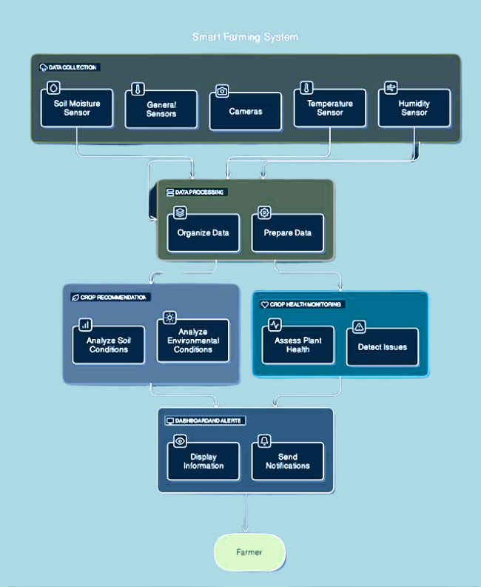

Slide 16
Methodology
Stage 1: Crop Reccomendation System.
Stage 2: IOT Device Setup.
Stage 3: Data Collection and Transmission.
Stage 4: Model Deployment and Integration.

Slide 17
Stage 1 : Crop Recommendation System
Features: Soil type, pH, temperature, humidity, rainfall.
Multiple decision trees
Majority voting for classification.
Data Preprocessing
Training
Validation (accuracy=98).

Slide 18
Stage 2: IOT Device Setup
IoT-based monitoring system setup.
ESP32: WiFi,Low power, Multiple General Purpose I/O (GPIOs).
pH sensor: Soil acidity
Temperature & Humidity sensor
Motor for irrigation based on sensor data.

Slide 19
Stage 3: Data Collection and Transmission
Soil Data Collection
Device Integration
Wireless Data Transmission
Cloud Storage
Real-Time Data Processing

Slide 20
Stage 4: Model Deployment and Integration
Creating a model for Crop Reccomendation System.
Using Flask to deploy the model.
Monitoring the data from Micro-Controller in the server
exporting Data in form of excel/csv file.

Slide 21
Functional Requirements
Sensor Data Collection
Data Transmission via LoRaWAN
Data Preprocessing
Cloud Storage
Anomaly Detection
Predictive Modeling
Real-Time Alerts and Notifications

Slide 22
Non Functional Requirements
Reliability
Scalability
Energy Efficiency
Data Security and Privacy
Real-Time Performance
Fault Tolerance
Usability and Maintainability

Slide 23
Technologies Used
ESP 32 Microcontroller for Data Collection and Data Transmission.
Artificial Intelligence (AI) and Machine Learning (ML) using Python.
Model deployment using Flask.
Cloud server used is Think Speak.(Free Version).

Slide 24
Results
Algorithm | Previous Value | Updated Value
Random Forest | 96.67 | 98.0
Decision-tree | 92.43 | 96.7
KNN Classifier | 98.18 | 97.5
Metric | Value
Accuracy | 92.7%
Precision | 91.5%
Recall | 90.8%
F1 Score | 91.1%

Slide 25
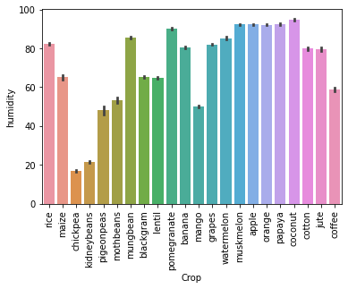
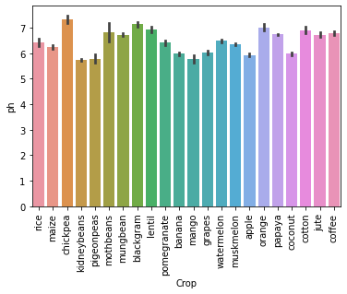

Slide 26
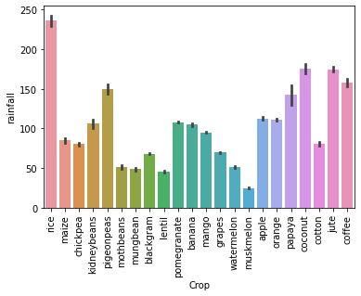
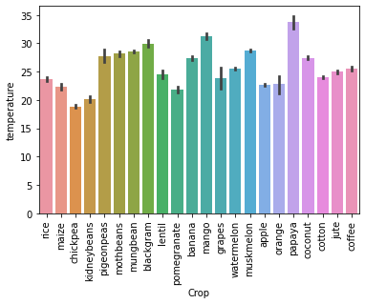

Slide 27
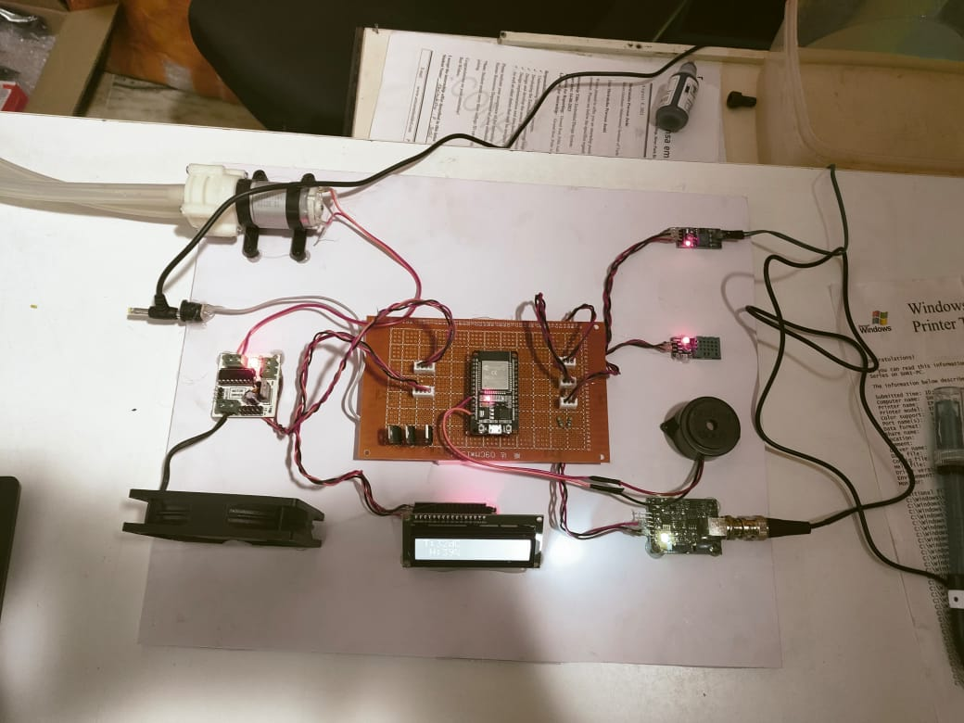

Slide 28
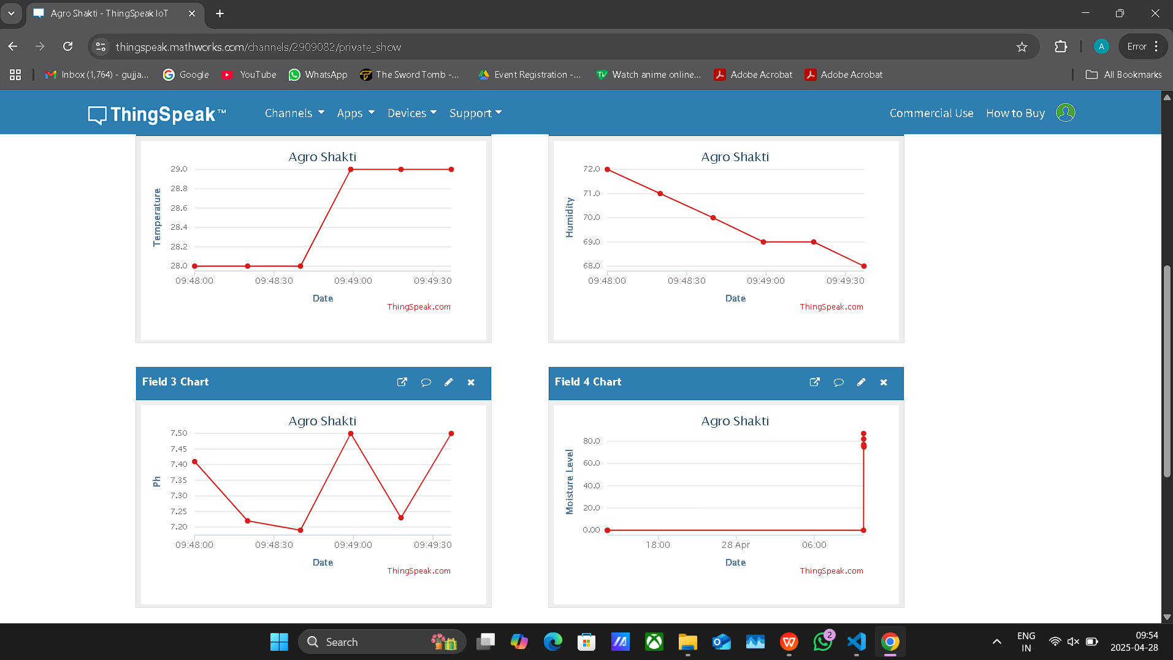

Slide 29
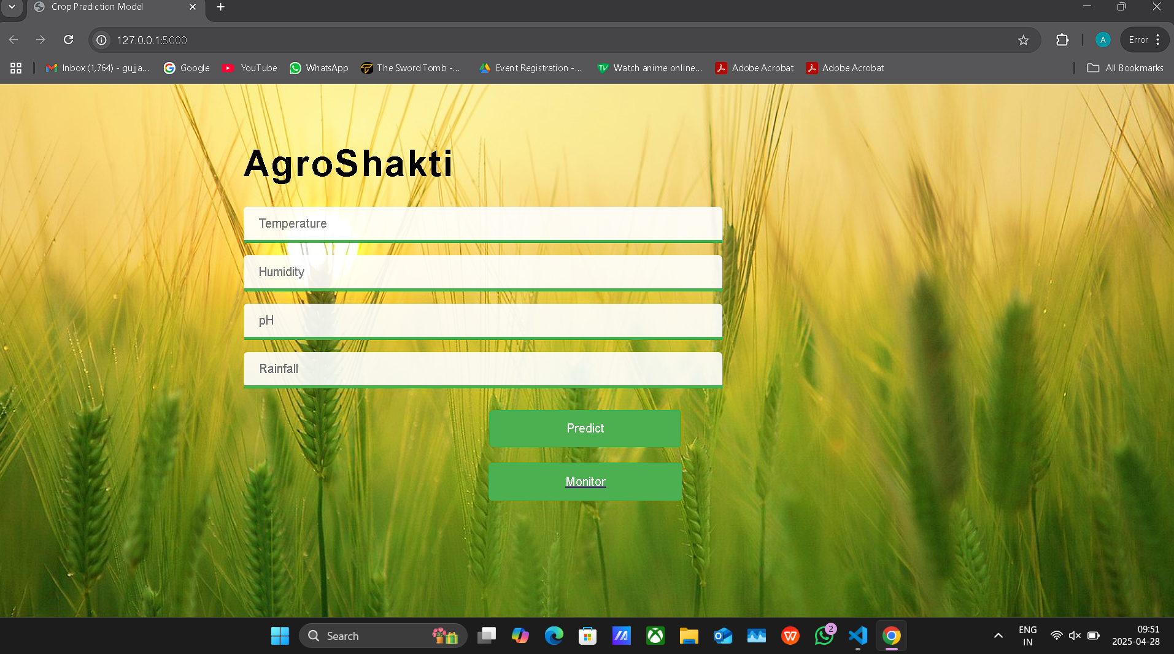

Slide 30
Conclusion
Real-time monitoring and reporting of soil moisture, pH, and nutrient levels.
Enhanced decision-making for farmers, leading to improved crop management and productivity.
AI models that continuously improve data collection, enhancing long term decision making.
Reduced dependency on manual labor through smart monitoring and control systems.

Slide 31
Future Scope
Leaf Disease Detection:- Using Image Processing we can prevent the growth/spread of disease in crops.
Addition of digital NPK sensor for monitoring Nitrogen, Phosphorous and Potassium levels.

Slide 32
References
Alumfareh MF, Humayun M, Ahmad Z, Khan A. An Intelligent LoRaWAN-based IoT Device for Monitoring and Control Solutions in Smart Farming through anomaly detection integrated with unsupervised machine learning. IEEE Access. 2024; 12:119072-119086.
John S, Arul Leena Rose PJ. Smart farming and precision agriculture and its need in today’s world. In: Smart and Sustainable Agriculture: Green Technologies and Innovations. 2024 Mar.
Yang H, Wen T, Yang X, Lin H. Deep learning agricultural information classification combined with Internet of Things technology in agricultural production and economic management. IEEE Access. 2022; 10:54713-9.
Kour VP, Arora S. Recent developments of the Internet of Things in agriculture: a survey. IEEE Access. 2020; 8:129924-57.
Neethirajan S. The role of sensors, big data, and machine learning in modern animal farming. Sens Bio-Sens Res. 2020; 29:100367.

Slide 33
Iyapparaja M, Alshammari NK, Sathish Kumar M, Siva Rama Krishnan S, Chowdhary CL. Efficient Resource Allocation in Fog Computing Using QTCS Model. Comput Mater Contin. 2022;70(2):2225–2239.
Kumar Apat, S., Mishra, J., Srujan Raju, K., Padhy, N. IoT-Assisted Crop Monitoring Using Machine Learning Algorithms for Smart Farming. In: Kumar, R., Pattnaik, P.K., R. S. Tavares, J.M. (eds) Next Generation of Internet of Things. Lecture Notes in Networks and Systems, 2023;445: 978-981.
Sanjeevi P, Prasanna S, Siva Kumar B, Gunasekaran G, Alagiri I, Vijay Anand R. Precision agriculture and farming using Internet of Things based on wireless sensor network. Trans Emerg Telecommun Technol. 2020;31(12): e3978.
Vaishnnave MP, Manivannan R. Chapter 4: An empirical study of crop yield prediction using reinforcement learning. In: Kanthavel R, Ananthajothi K, Balamurugan S, Ganesh RK, editors. Artificial Intelligent Techniques for Wireless Communication and Networking. Hoboken (NJ): Wiley; 2022.
G. Mohyuddin, M. A. Khan, A. Haseeb, S. Mahpara, M. Waseem and A. M. Saleh, "Evaluation of Machine Learning Approaches for Precision Farming in Smart Agriculture System: A Comprehensive Review," IEEE Access, 2024;12:60155-60184.

Slide 34
Thank You

